Slide 1

International Forum on Adopting an ICT Perspective to Education and Learning
Assistive Technologies in School Education: Exemplar Inclusive Learning Material
Day 2: Expanding Equitable Access using ICT
Prof. Anupam Ahuja
ahujaa56@gmail.com
Head, Department of Education of Groups with Special Needs
NCERT, New Delhi
November 01, 2016
November 01, 2016

Slide 2
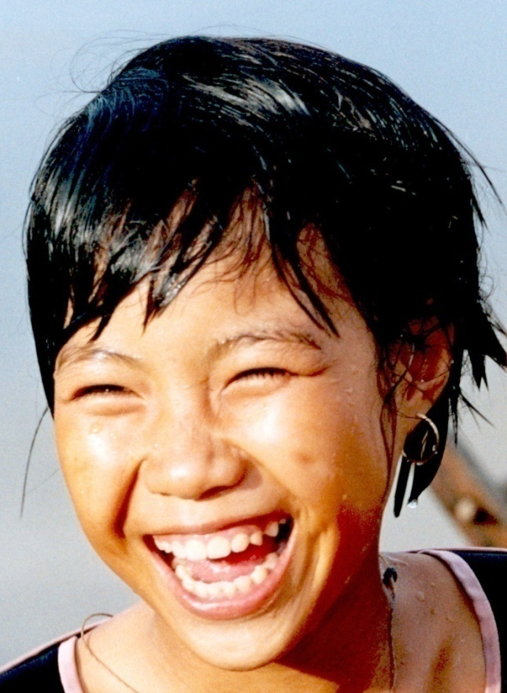
“All for the Children for All the Children”
Common belief
ALL DIFFERENT
YET
ALL EQUAL
Inclusive education addresses the needs of each individual learner with special focus on those who are vulnerable to marginalization or exclusion

Slide 3
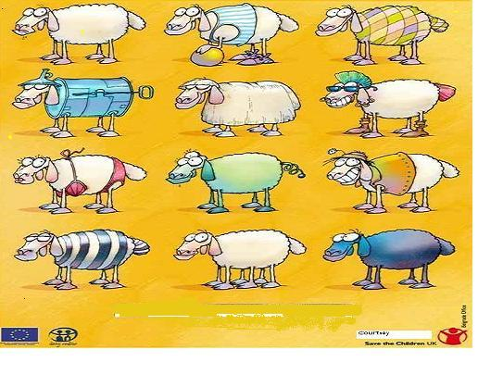
Do I really have the right to be different ?
EXCLUSION HAS OFTEN A SOCIAL, LINGUAL, FINANCIAL BASE…
ANY OTHER ?
Notes:
We need to look closely at the children who have become invisible : at exclusion which has often a social, financial, ethnic , and lingual base.
We need to look beyond children with disabilities as implementing rights can be never limited to only one group of children!

Slide 4
Hearing something hundred times is not better than seeing it once. . .

Slide 5

All children Read One Book
Facilitates
True Inclusion
Barkhaa: A Reading Series for 'All‘

Slide 6
Contents
Part I : Orientation to Barkhaa ( Original Reading Series)
Part II : A Story( Sample )
Part III : Developing (UDL based) Barkhaa Reading Series for All Children (Process)
Part IV : Print Version- The Reading Series with Additional Features
Part V : Digital Version-The Reading Series with Additional Features

Slide 7
Part I
Orientation to Barkhaa(original Reading Series)

Slide 8
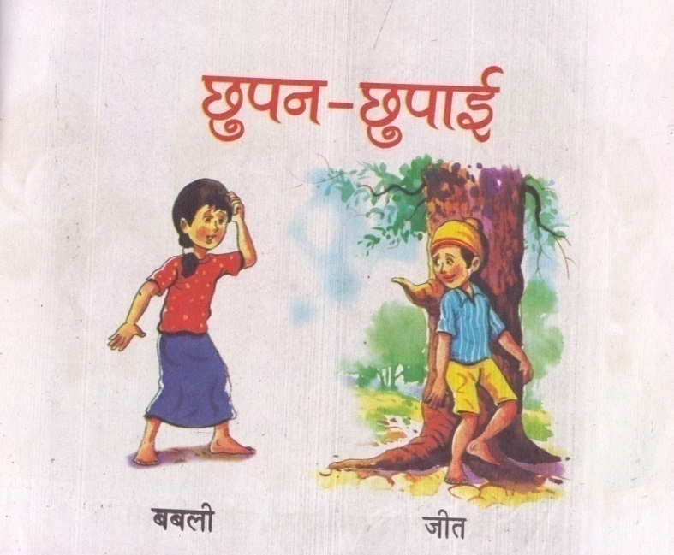
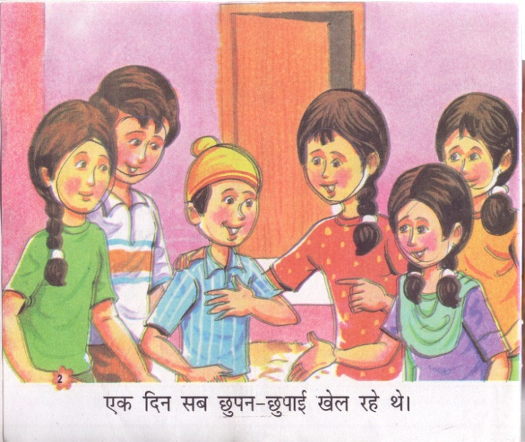
The Barkhaa Series
Barkhaa a ‘Graded Reading Series” developed by Department of Elementary Education(DEE), NCERT
Focus on developing reading skills during early years enabling children of classes I and II to:
Develop reading skills
Learn to read with meaning and for pleasure
Re-read previously read books
Understand several concepts from new perspectives
    Each page has a visual and text

Slide 9
Barkhaa Series: Format
Barkha Series
Four levels:
Level 1
Level 2
Level 3
Level 4
40 Stories
Each story in the form of a small booklet across 4 levels and 5 themes
Five Themes:
1. Relationships
2. Birds-Animals
3. Musical instruments
4.Games and Toys Around Us
5. Food

Slide 10
About the Stories of the Barkha Series
Stories based on children's contexts and everyday experiences.
Every theme has eight stories revolving around events/problems
Illustrations on every page- to give flight to children’s imagination.
Sentences are based on spoken language
Characters are of intended readers’ age
Variation in levels:
Sentences and illustrations
Number and complexity of sub-plots
Syntax

Slide 11
Levels are color coded
Two sentences with an Illustration on every page
Increased repetition in the syntax
Four sentences on every page
Two to three plots
Repetition in the plots but very little in the syntax
Level 1
Level 2
One sentence with an illustration on every page
Repetition in the syntax-helps children recognize words
Three sentences on each page
Two to three smaller events or sub-plots
Level 3
Level 4

Slide 12
Part II
A Story

Slide 13





Ameena: Hi I love reading.
I have a room full of story books.
Neha : My parents bought me a Tablet to read stories. I have over 100 stories and while reading I can make the picture big and small.I can also change the background color . It helps me get good contrast
Mohan : Oh! I also love reading story books. My mother reads the stories aloud to me and I have few story books in Braille.
Raj: I visit the library once in a week. I enjoy reading stories on friendship and animals. My story books have big pictures and large font size
Saumya : I like reading books with few pictures and sentences. My friends help me turn pages.

Slide 14
Let us put on our thinking caps!
How can we promote reading with meaning and pleasure among all children( including Ameena, Neha, Mohan, Saumya and Ra and many others ) in inclusive settings?
Can we provide one book for all to read?
Can we use ICT to cater to the diverse/unique reading needs of all children?
The reality is:
Children with disabilities often shy away from independent reading.
Respecting the reading choices all children is crucial but poses a challenge .

Slide 15
Part III
Developing(UDL based) Barkhaa Reading Series for All Children- Process

Slide 16
Barkhaa: A Reading Series for ‘All’
A series of workshops and consultations with a multidisciplinary team of experts and practitioners at the national level.
This led us to the following conclusions
  All children in the classroom ought to have the opportunity to use the same book.
  Transaction of syllabus only through prescribed textbooks leads to disenchantment which often inhibits reading for pleasure.
  Therefore there is a need to go beyond textbooks and highlight the significance of supplementary reading.
  The use of one book for all builds a sense of confidence and camaraderie among peers, leading to inclusive societies.
  This can be achieved through the use of assistive technologies and incorporating principles of Universal Design for Learning (UDL) in the books.

Slide 17
Adapting the Barkhaa Series
Rationale (why the adaptations?)
To provide supplementary reading material for early graders in inclusive classrooms according to Universal Design for Learning (UDL) principles.
Respecting diverse reading ways and choices
Provide all young readers’ including CWSN, access to Barkhaa as a reading material
To give multi-sensory experiences to the readers (Tactile, audio and video)
First time NCERT has ventured into the area of adapting reading material for early graders according to UDL principles.

Slide 18
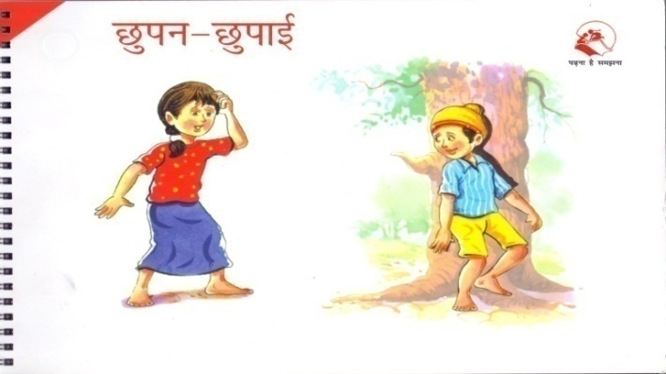
Adapted Barkhaa - A Reading Series for ‘All’
Unique Features
Accessible and customised reading material addressing unique learning needs for all young readers including CWSN
All 40 Booklets are adapted both in PRINT and DIGITAL VERSION according to UDL while retaining the essence of the original Barkhaa series
Digital version has been released by the Hon’ble State Minister of MHRD on the 56th Foundation Day of NCERT (1st September, 2016).
All children read ‘one book’- true inclusion

Slide 19
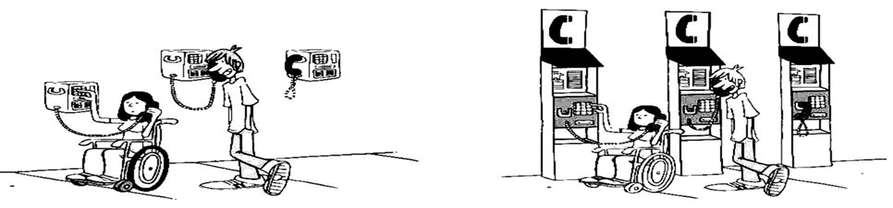
UNIQUE INITIATIVE
Preparing reading material for early graders according to Universal Design for Learning (UDL) principles
UDL

Slide 20
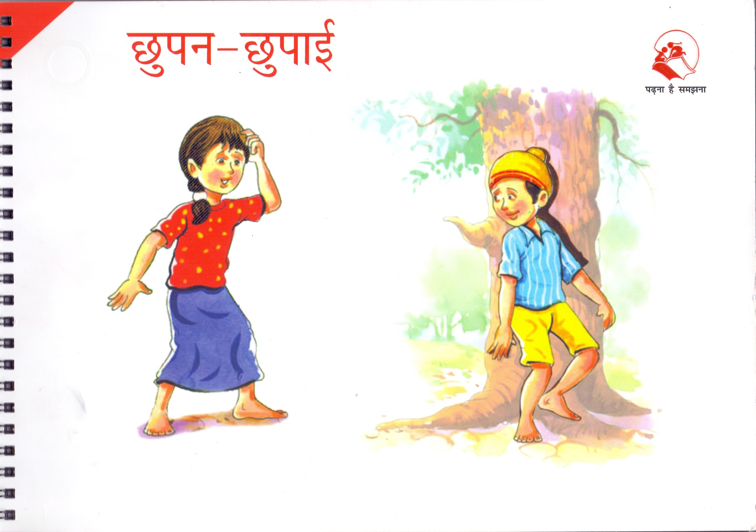
Part IV
Print version- The Reading Series with Additional Features

Slide 21

PRINT VERSION
Barkhaa: A Reading Series for ‘All’
All children read ‘one book’- true inclusion

Slide 22
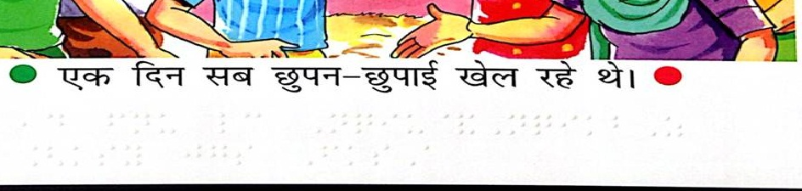
Adapted Barkhaa Series – Key Features of Printed Version
Text in print and Braille on same page, thus accessible to all children and promoting collective reading
Poly Braille is used:
Invisible
Much longer shelf life than Conventional Braille
Can be used on both sides of the paper
Can be imposed on printed text making it accessible to all including the non sighted.
Contd…

Slide 23
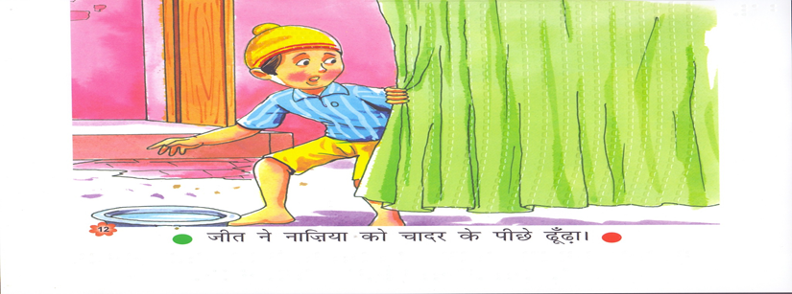
Visuals made accessible in tactile form (embossing and computerised texturing), thus accessible to all children
Computerised texture of curtain and turban of Jeet
Embossed Face outline
Contd…

Slide 24
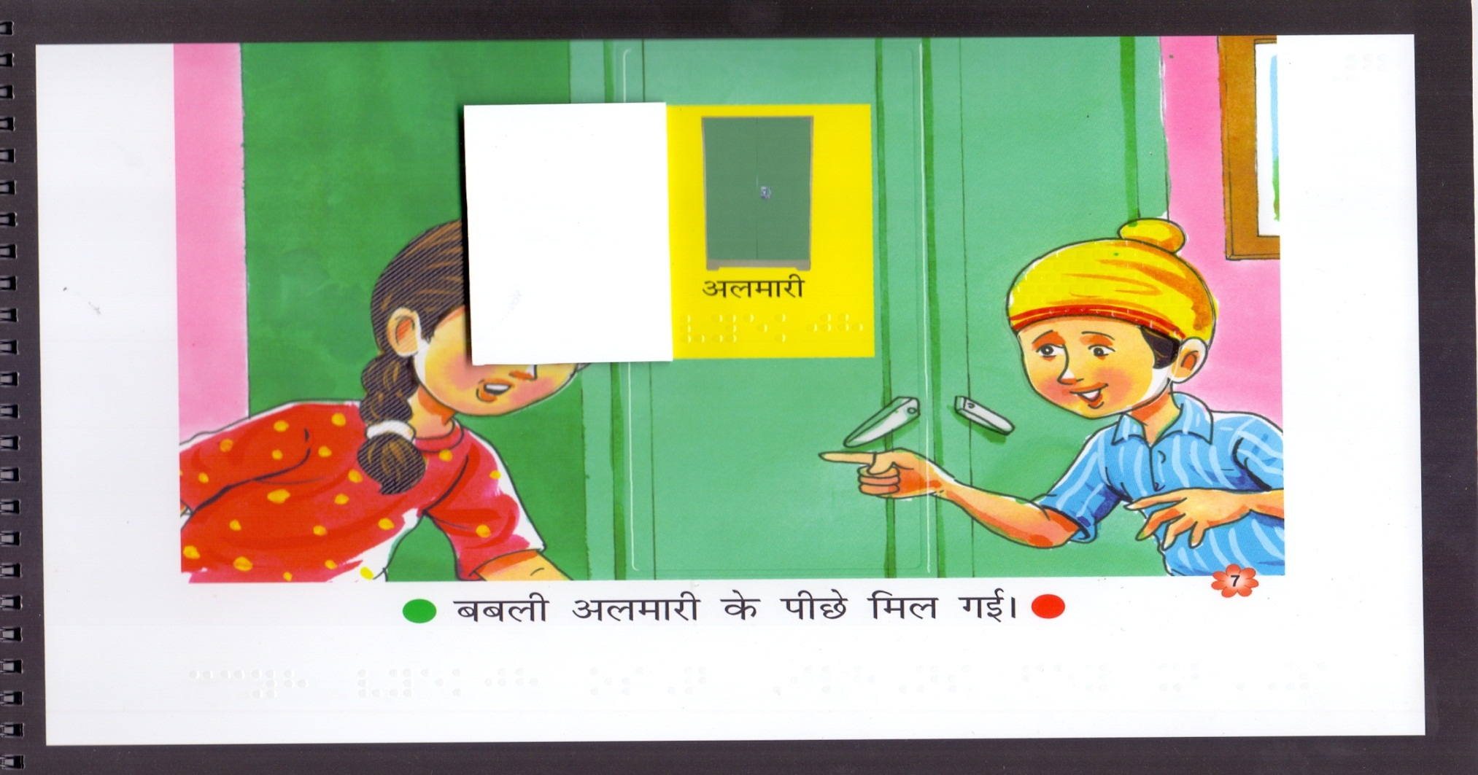
Picture windows / flashcard for key words (in print and Braille) to reinforce words through real images
Contd…

Slide 25
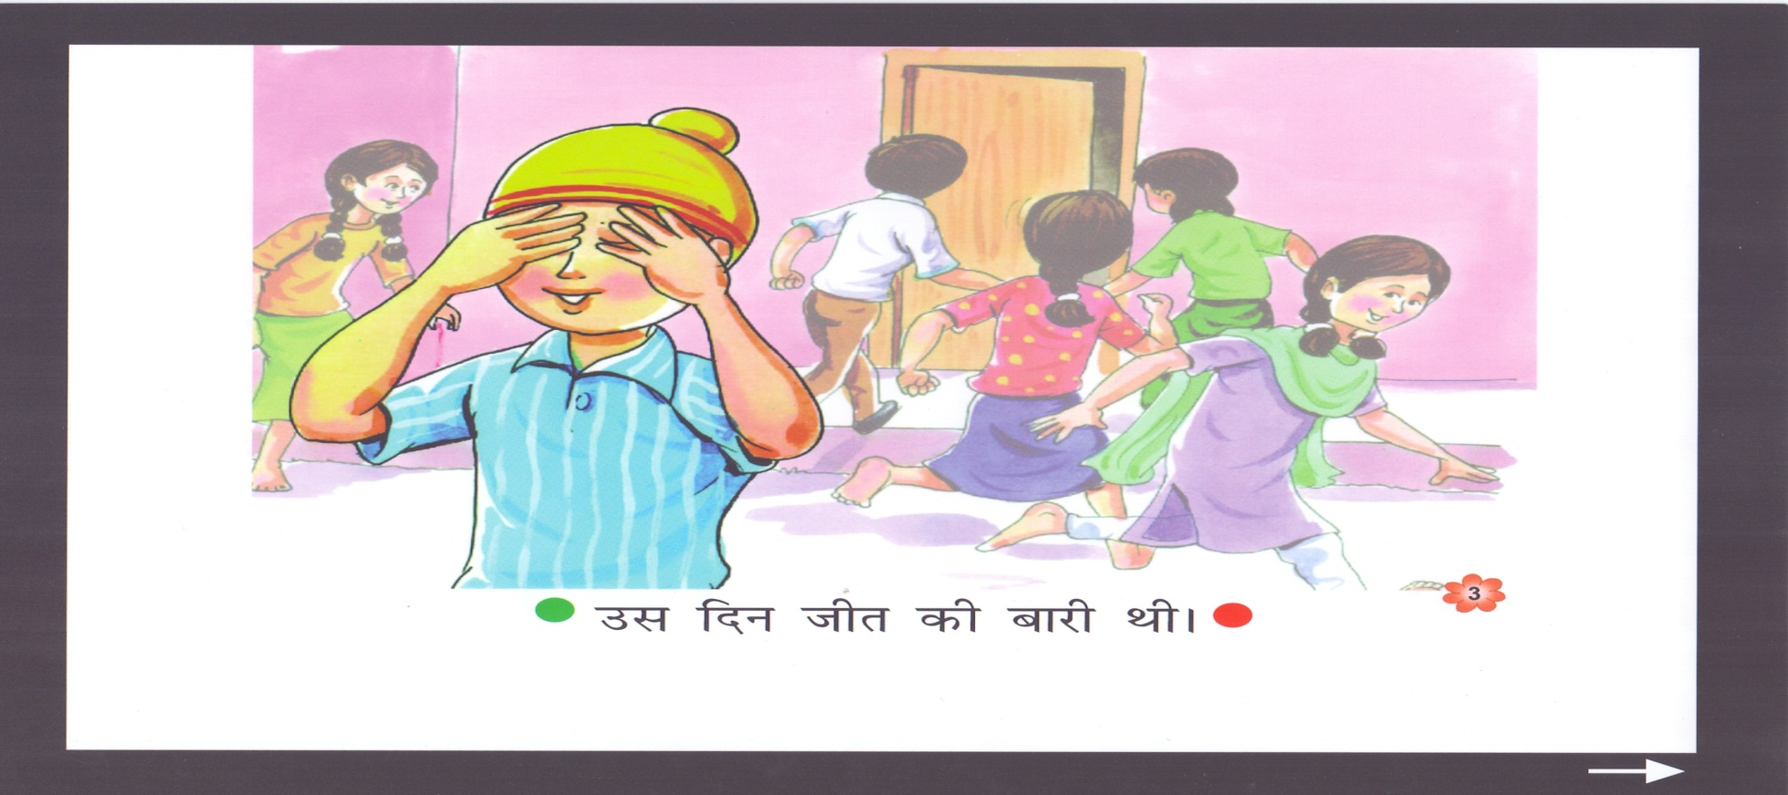
key visuals on each page in the book are made in high resolution. to focus on the important events of the story.
Contd…

Slide 26
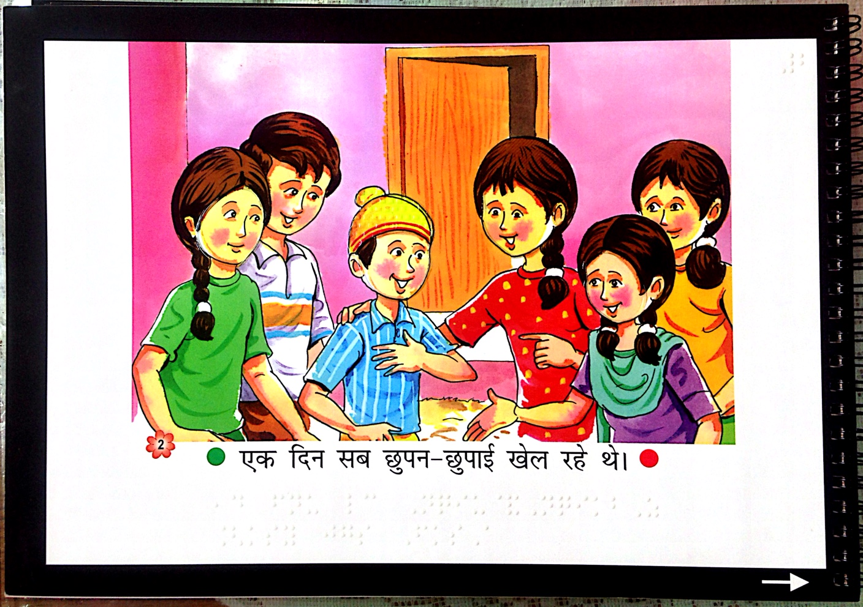
1. Black border on all four sides to bring focus to the illustration and text.
2. Green dot and red dot to indicate beginning and end of the sentences
3. Arrows that indicate next page
Contd…

Slide 27
Adapted Barkhaa Series – Other Key Features of Printed Version
To facilitate ease of use, the pages used are thicker and of higher qualityAppropriate thick sheets (220 GSM). It also accommodates Braille text on both sides
Page gradation to make it easy for all children to turn each page.
Safe and durable binding using ‘wiro’, binding( use of staples can be dangerous for young children)
Regular book binding will not allow the books to open flat for Braille reading.
A Note for Teachers and Parents at the end of each story booklet in Hindi and English to facilitate reading. This note includes a story introduction to each story. to raise curiosity, clarify certain concepts and motivate children to read. Parents and teachers are expected to read this note aloud to the children.

Slide 28
Part V
Digital Version-The Reading Series with Additional Features

Slide 29
Technology: An Equalizer
Technology – a great equalizer in an inclusive classroom with diverse learners.
    “For people without disabilities, technology makes things
    easier. For people with disabilities, technology makes things possible” – IBM Training Manual, 1991
Assistive technologies can help in mastering effective reading strategies which enable children with varying needs to excel in the future.
Exemplar – Barkhaa: A Reading Series for ‘All’

Slide 30
Preview of the DIGITAL VERSION
of
Barkhaa: A Reading Series for ‘All’

Slide 31




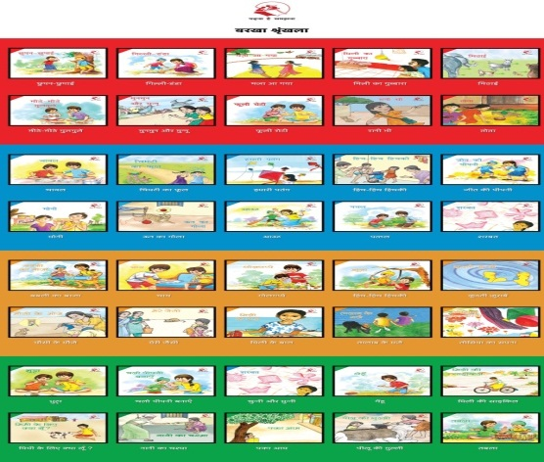


Adapted Barkhaa Series –
Key Features of Digital Version
  Can be accessed on computers, laptops, mobile phones and tablets. To be available on NCERT website as part of e-pathshala
  All the features of the print version are retained in the digital version which is accompanied by a how to use section.
  Friendly packaging : 40 story book cover pages displayed in a bookshelf
  ‘How to Use’ page
  The introduction of each story booklet is in video and sign language formats. Helps to arouse curiosity and make reading interesting

Slide 32


Adapted Barkhaa Series – Key Features of Digital Version (Contd.)
Content can be viewed in 3 different background colour combinations for the child to view as per preference and need.
Flash cards appear highlighting key words with a picture to reinforce words through real images.
Key visuals on each page made in high resolution.
Note for Teachers and Parents at the end of each booklet in Hindi and English to facilitate reading.
Link of the digital version on the NCERT website
http://www.ncert.nic.in/departments/nie/degsn/NCERTBarkhaseries/Start.html

Slide 33
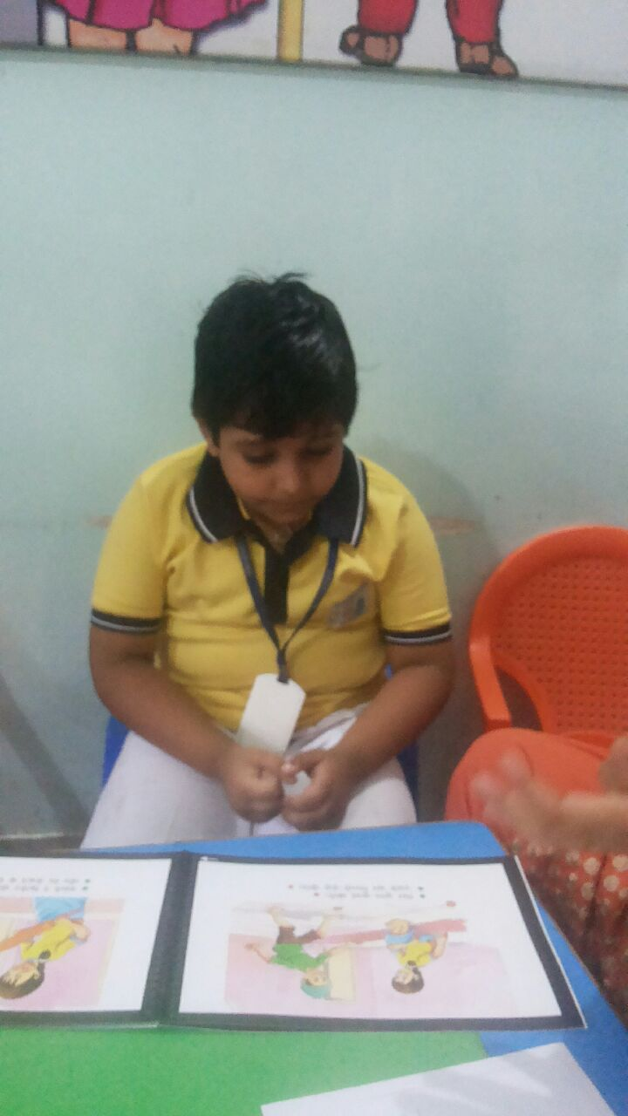
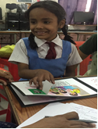
Glimpses: Try out of the print version of the adapted Barkhaa: A Reading Series for ‘All’
Try out of the printed booklet in Maharani Gayatri Devi Girl's School, Jaipur, Rajasthan
Try out of the printed booklet in Bloosoms School, Bhubaneswar

Slide 34
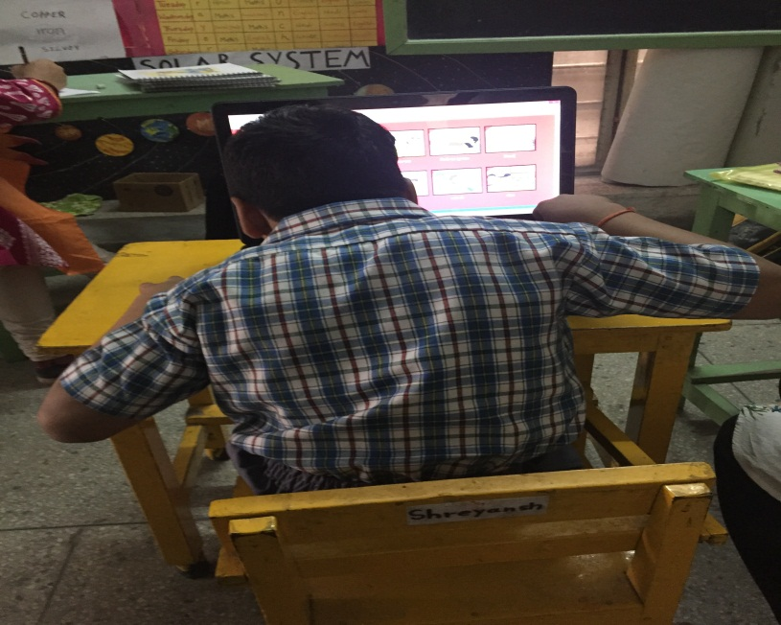
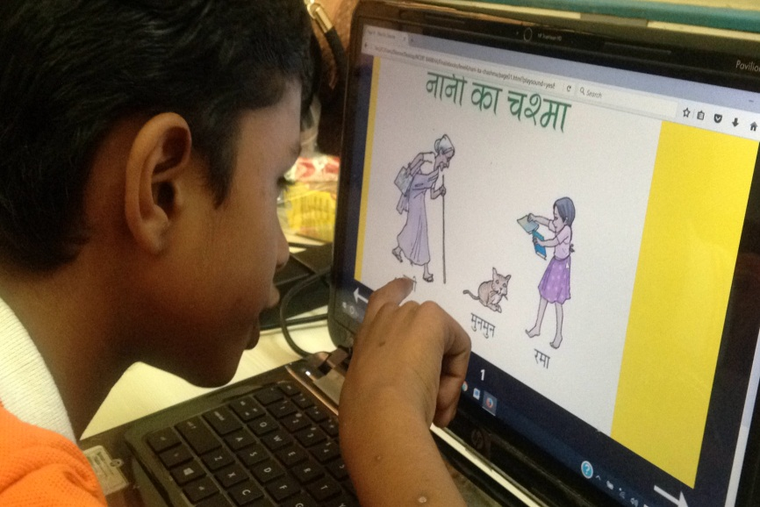
Glimpses: Try out of the digital version of the adapted Barkhaa: A Reading Series for ‘All’
Try out of the Digital booklet in Saksham , Delhi
Try out of the Digital booklet in Umang, Jaipur, Rajasthan

Slide 35
Reflect …
How do you plan to develop and use the print and digital versions of Barkhaa: A Reading Series for ‘All’ / or similar reading material in your context fr all children your schools ?
NEXT STEP( in progress)
Handbook for promoting reading among all children is in progress….

Slide 36
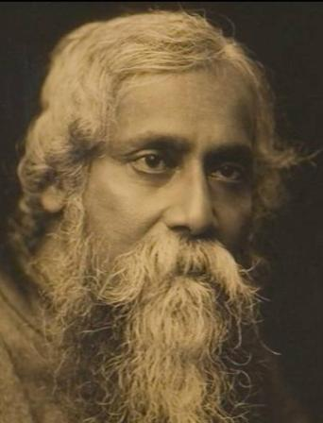
“The problem is not how to wipe out the differences but how to unite with the differences intact.”
- Rabindranath Tagore

Slide 37
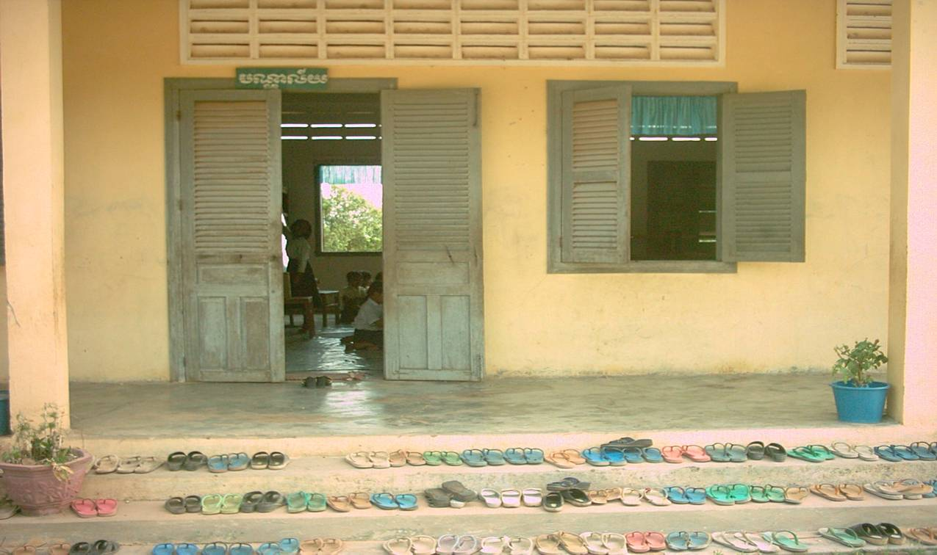
Inclusive education is a constant process…of system transformation and whole school improvement to ensure that Education for All really is for ALL!
Notes:
Inclusive education is a way to ensure that Education for All is truly for ALL!!

Slide 38
TOWARDS INCLUSION
Change the system to fit the need of All
children
In ordinary
Schools
In Special
Schools
No Access to
Schools
Other Children
Children with Special Needs
disadvantaged children
Notes:
38

Slide 39
A Businessman and the Teachers
Mr. Ravi , an executive at Mitha Mitha, an ice cream company in India was representing a group of business people dedicated to improving public schools. He and his company had became famous in the middle 1980s when their ice cream was named as the ‘Best Ice Cream in India'.
Mr. Ravi told to an auditorium filled with teachers who have come to receive in-service training ‘If I ran my business the way you people operate your schools, I wouldn’t be in business very long!’ He was convinced of two things.
First schools needed to change; they were outdated and out of step with the needs of our emerging “knowledge society.”
Second, teachers were a major part of the problem: they resisted change and most importantly they needed to look to business.
As a businessman, Mr.Ravi felt that he is the perfect man to orient the teachers on how to produce quality with Zero defects and Continuous improvement!
As he finished, a woman’s hand shot up who had been waiting to speak up. Her name was Ms.Sneha and she was a high school English teacher.
She began quietly, “We are told, Sir, that you manage a company that makes good ice cream.”

Slide 40
A Businessman and the Teachers
Mr.Ravi smugly replied, “Best ice cream in India, Ma’am.”
“How nice, “she said. “Is it rich and smooth?”
“100 percent smooth, silky and rich,” he crowed.
“high quality ingredients?” she inquired.
“Super-premium” he retorted.
“Mr. Ravi” she said, very pertinently “when sometimes you see inferior quality of Mitha Mitha being produced, what do you do?”
Mr. Ravi replied “I send them back.”
“That’s right!” Ms. Sneha said, “and we never send back our children. We love all our children.
We take them big, small, rich, poor, gifted, exceptional, abused, disabled, frightened, confident, homeless, rude, and “ brilliant”. We take them all! Every one!
And that, Mr. Ravi, is why it’s not a business. It’s school!”

Slide 41
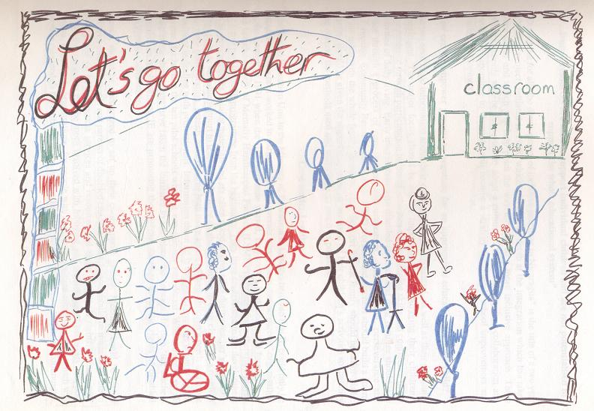
Journey towards ‘Inclusion’
Enable schools to
include diverse learners
Draw on all existing
resources
Celebrate
Differences!
Welcome
all learners
Poster from: IE making a difference; An international disability and development Consortium Seminar on IE; Agra India, EENET, SC
Thank You

